Slide 1

The Lawyer in School Program
The Program
The Lawyer in School Program (LISP) is a program that helps the school community become aware of, understand and navigate the legal system. A lawyer attends the school weekly, to help students and parents with their legal issues.
Currently, there are approximately 10 lawyers attending Victorian schools to assist and educate students, teachers and parents about legal matters. The program is proving to be beneficial because it is expanding into New South Wales, Western Australia and the Northern Territory.
Purpose
The LISP aims to:
educate students and parents about the law, and
facilitate access to a lawyer if a student or parent has a legal problem.
The importance of lawyers in schools
Lawyers are people who understand the law. They are important in schools because they can:
assist students and parents with their legal problem quickly in a familiar and safe environment;
reduce the stress and anxiety associated with a legal problem;
inform and support students about the law so they can become enabled and responsible citizens;
refer students and parents to appropriate services if required;
provide students and parents with a voice within the relevant legal system, and
represent students and parents at court if required.

Slide 2
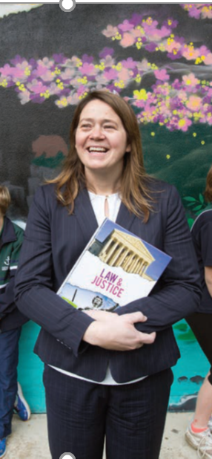
Newcomb Secondary College’s School Lawyer
The school lawyer at Newcomb Secondary College is Alison Lever. Alison can provide information and advice in relation to the following:
Issues with police
Fines
Problems at home
Domestic violence
Problems at work
Cyberbullying
Cyber safety
Appropriate use of mobile phones
Child protection issues
Traffic offences
Other legal issues can also be discussed with Alison because she has access to extensive resources within Victoria Legal Aid.
Meeting the School Lawyer
Alison attends Newcomb Secondary College predominantly on Fridays but can attend at other times if an appointment has been booked through the Wellbeing staff at Newcomb Secondary College.
She can be located at the Wellbeing Centre (Cubbies) from 8.30am-3.30pm each Friday during term time. Alison’s contact details are as follows:
Telephone: 5226 5666 or
Email: Alison.Lever@vla.vic.gov.au

